Slide 1


The Billion Dollar Question:
Is 's
New UI Worth It?
Ofelia Akopian, Alex Mateu,
Sarah Jane Nede, Bruno Sousa

Slide 2

Project overview
Business question: Does the new Vanguard UI design drive higher process completion rates, and if so, does the improvement justify the investment?
Hypotheses:
1: Completion Rate
H₀: The new design does not increase the completion rate compared to the old design. The completion rate in the Test group is less than or equal to the completion rate in the Control group.
H₁: The new design increases the completion rate compared to the old design. The completion rate in the Test group is higher than the completion rate in the Control group.

Slide 3
Project overview
2: Completion Rate with a Cost-Effectiveness Threshold
H₀: The new process design does not achieve the minimum required increase in completion rate. The difference in completion rate between the test group and the control group is less than 5%, meaning the new design is not cost-effective
H₁: The new process design achieves or exceeds the minimum required increase in completion rate. The difference in completion rate between the test group and the control group is 5% or more, meaning the new design is cost-effective and its benefits outweigh the associated costs of design, development, testing, staff training and potential user disruptions.
3: Completion Rate according to tenure years
H₀: The completion rate of the new process does not differ significantly from the old process across tenure groups
H₁: The completion rate of the new process differs significantly from the old process across at least one tenure group

Slide 4
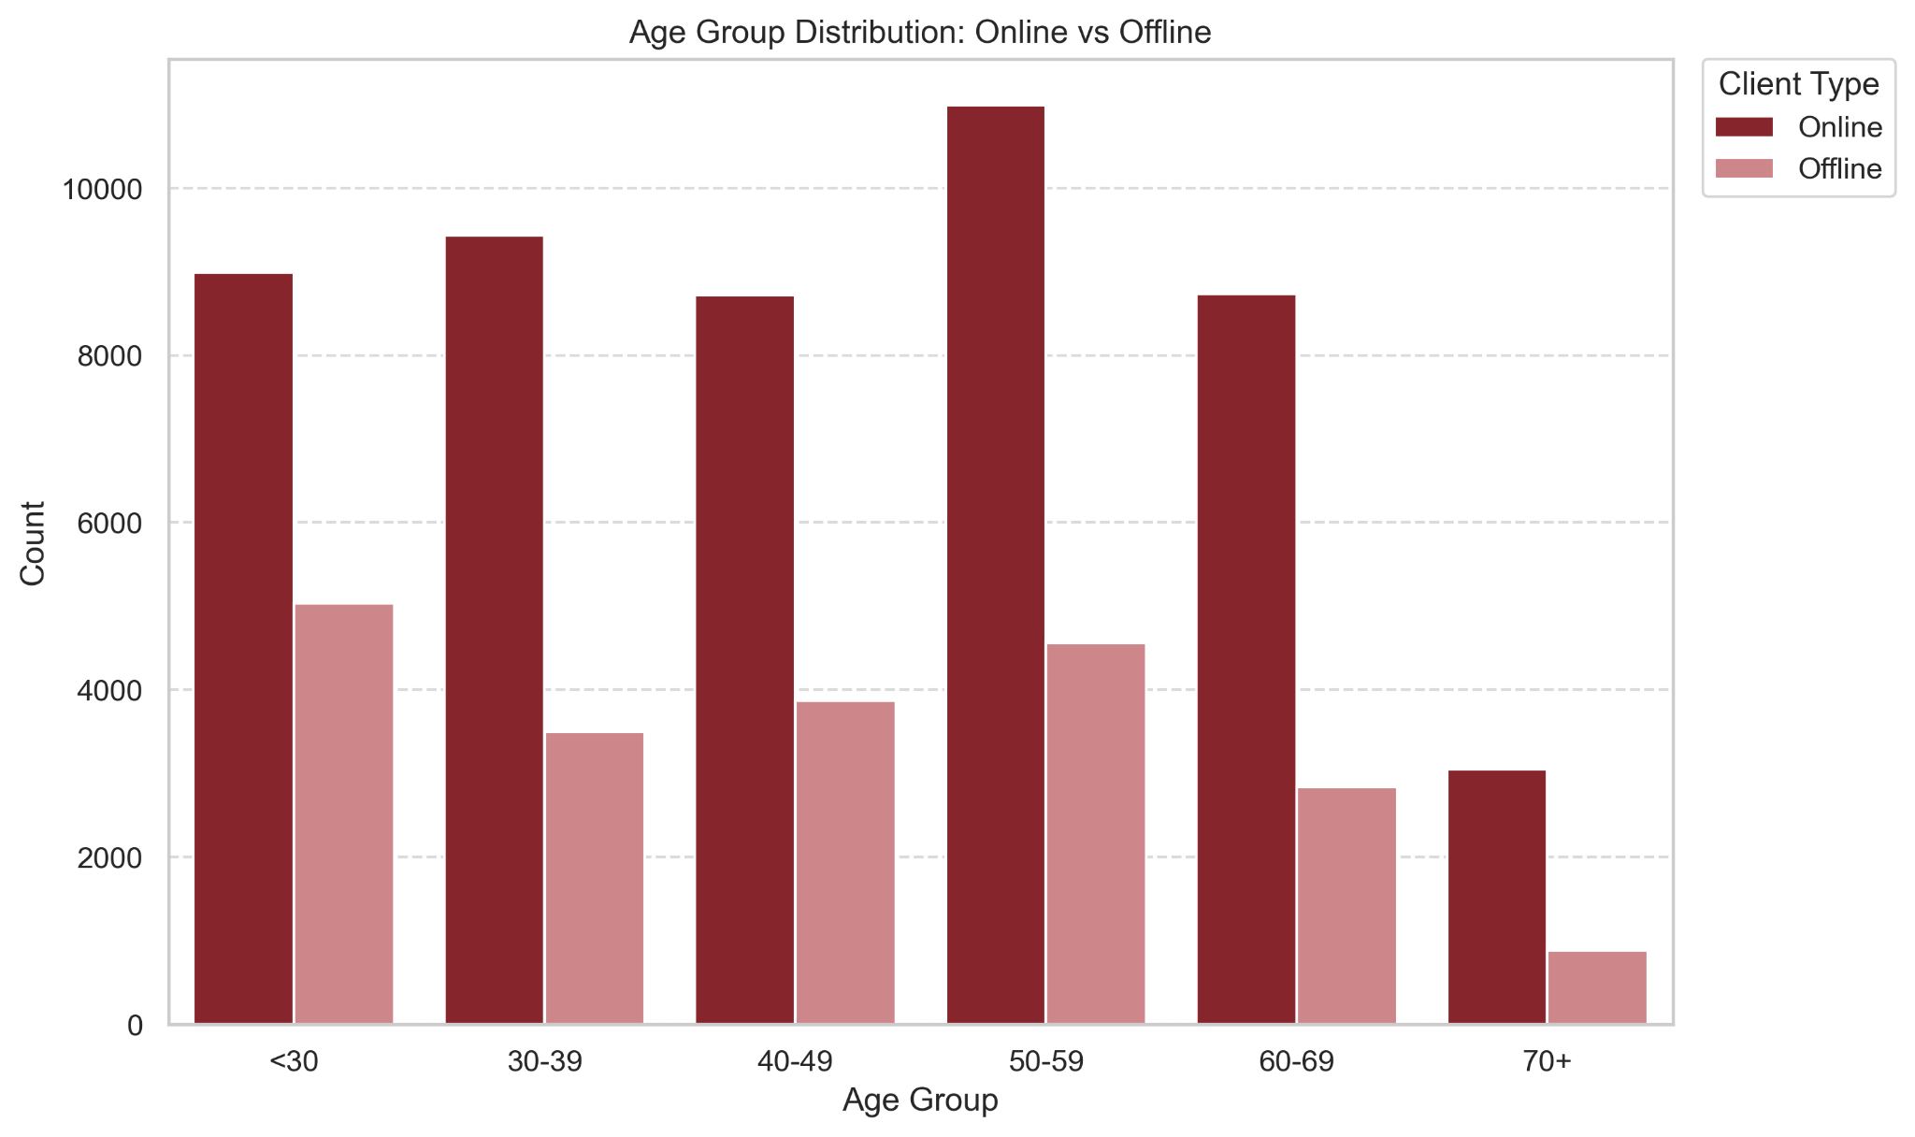
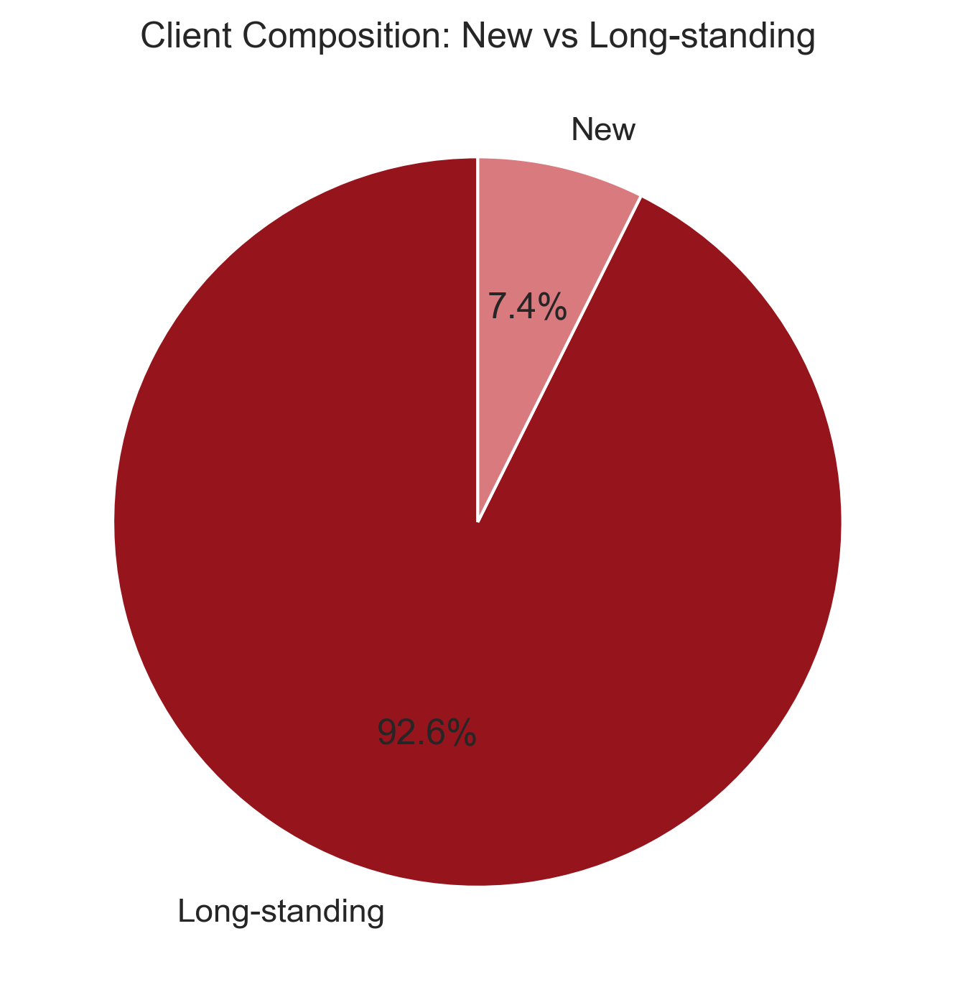
Client analysis
The primary users are established, middle-to-older aged clients

Slide 5
Hypophethis 1
===============================
RELATIVE UPLIFT ANALYSIS
===============================
Control completion rate : 65.59%
Test completion rate : 69.29%
-----------------------------------------------------
Absolute difference : +3.71 pp
Relative uplift : +5.65%
-----------------------------------------------------
Chi-square statistic : 78.5880
Degrees of freedom : 1
P-value : 0.000000
-----------------------------------------------------
✅ Significant at 95% confidence level
✅ Test performs 5.65% better than control
===========================
Statistical Analysis:
With a chi-square of 78.5880 and p-value ≈ 0, the probability that this difference arose by chance is negligible. The result is reliable across both groups.
5.65% relative uplift means that for every 100 users who previously would not have completed the process, approximately 6 additional users now complete it in the test variation.
Business Impact:
Scaling this to all traffic means thousands more completions per period with no additional acquisition cost.

Slide 6
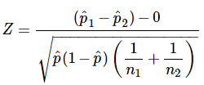
Hypophethis 2
Completion Rate with a cost-effectiveness threshold of 5%
Two proportion Z-test:

Slide 7
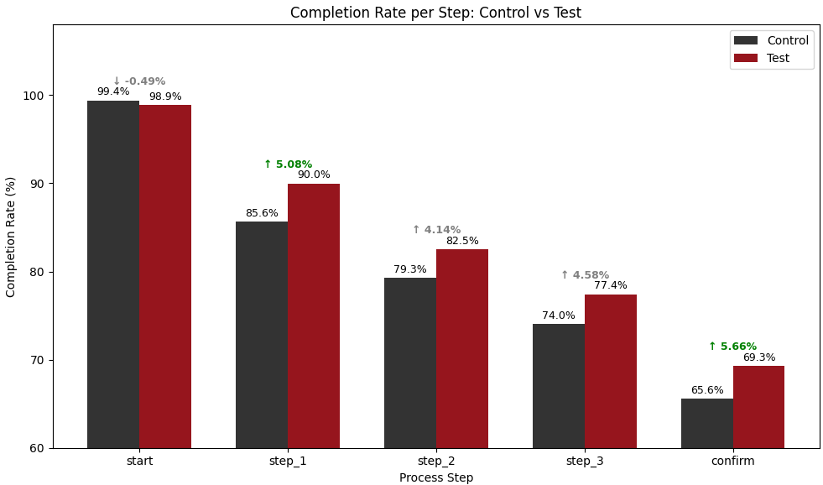
Hypophethis 2
Completion Rate with a Cost- effectiveness threshold of 5%
The new test version shows improvements in every step, but doesn't reach the minimum 5% threshold required except in 1 and confirm.
Its VERY IMPORTANT to note that these improvements didn't happen by chance, that's why we did the Z test.
In one step they might be over 5% , but also, if that was the case, it would have needed to pass the Z-test as well.

Slide 8
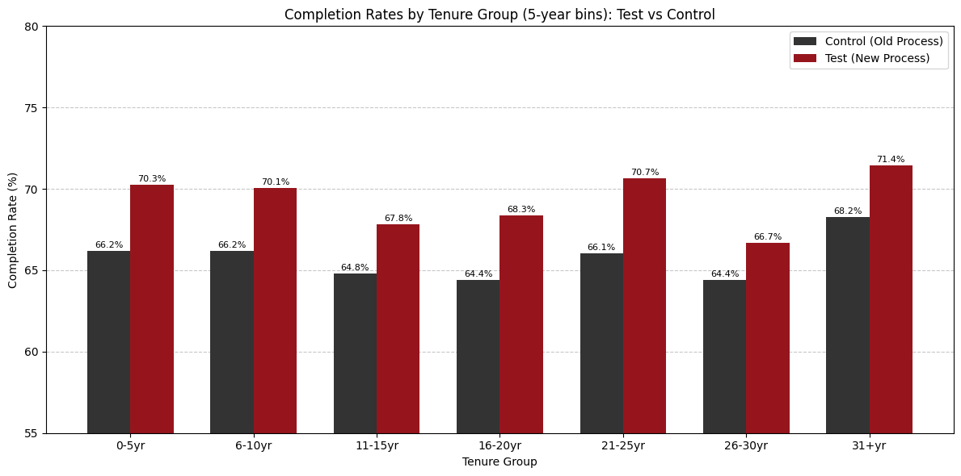
Hypophethis 3
Completion rates per tenure group:
The new process works better for most clients — especially newer clients (0-10 years) where the difference is biggest (3.9%)
The gap is consistent (~4 percentage points) across New, Mid and Loyal groups
Veteran (30+yr) has the smallest gap — so long-tenured clients still benefit from the new UI, just slightly less than other groups

Slide 9
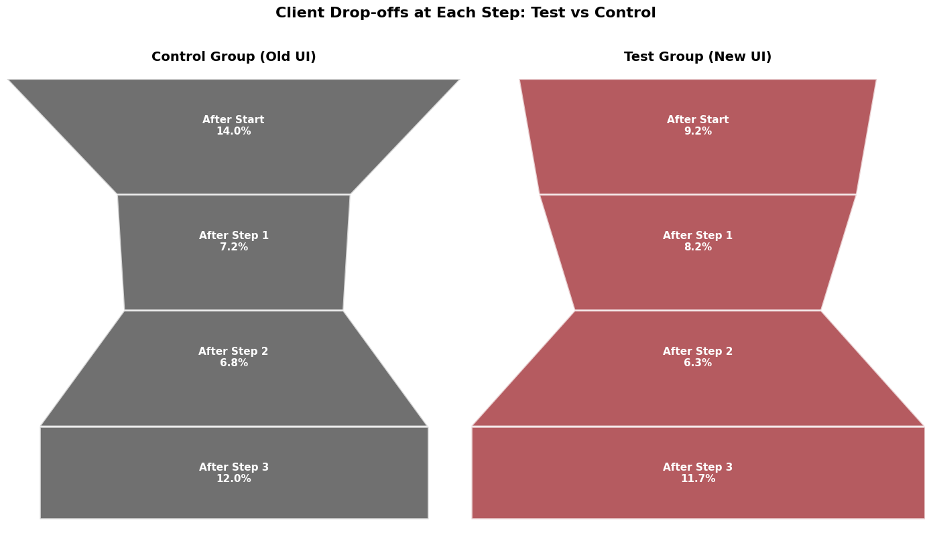
Additional Insights
Process integrity issue:
Irregularities going through the steps
Drop off rates per step:
Biggest win for new UI: After Start: 14% vs 9.1% — the new UI is much better at keeping clients engaged initially!
Problem area → After Step 1: the new UI loses slightly more clients here — something about Step 1 needs improvement!
Step 3 is the biggest drop-off for BOTH groups → this step needs attention regardless of which UI is used!

Slide 10
Data cleaning & obstacles
Data Preparation & Team Alignment:
Dataset was largely clean → no major obstacles
Removed rows with only null values (except client_id)
Merged df_final_web_data_pt_1 and df_final_web_data_pt_2
Challenges:
Main challenge: team alignment & communication
Some misunderstandings despite regular communication
Different approaches to handling encountered errors
Dealing with calculating time on each step
Outcome:
Error rate ultimately low
Required later-stage realignment
Provided useful insights into process and collaboration

Slide 11

Time spent on each step
Way to proceed:
Selecting the sample: “normal” process
Mean vs Median (outliers)
Control
vs
Test

Slide 12
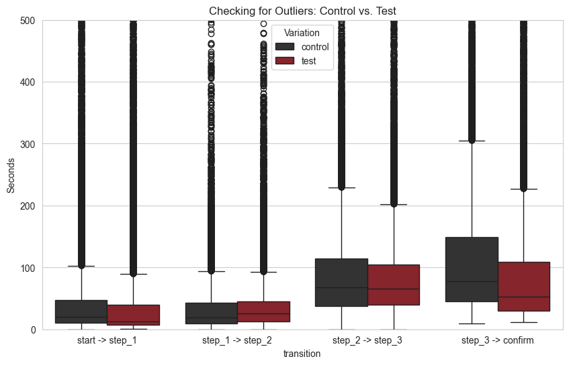
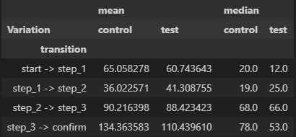
Median vs Mean
Cleaning the mean

Slide 13
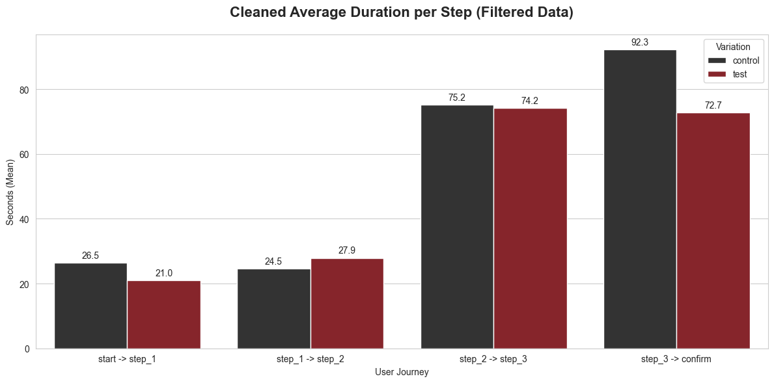
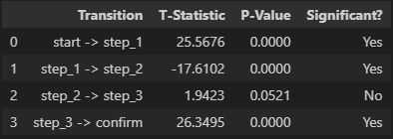
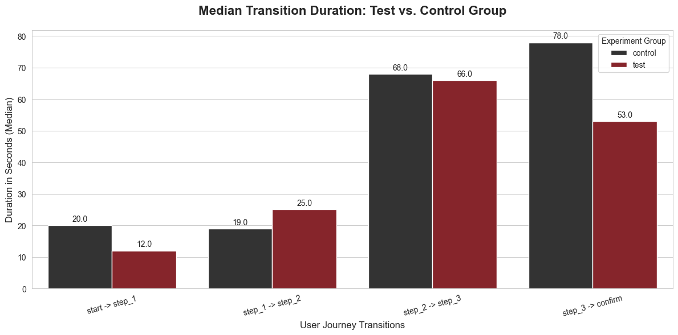
Median vs Mean

Slide 14
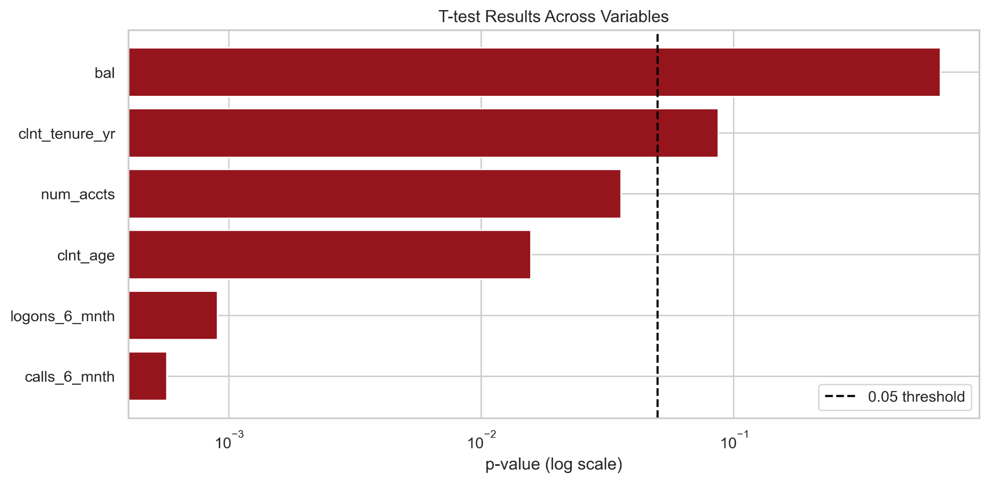
Experiment evaluation
The t-test is used for numerical variables to compare mean values between groups.
Behavioral metrics such as logons and calls show statistically significant differences (p < 0.05).
The experiment groups are partially imbalanced, particularly in user behavior, which may bias the results.

Slide 15
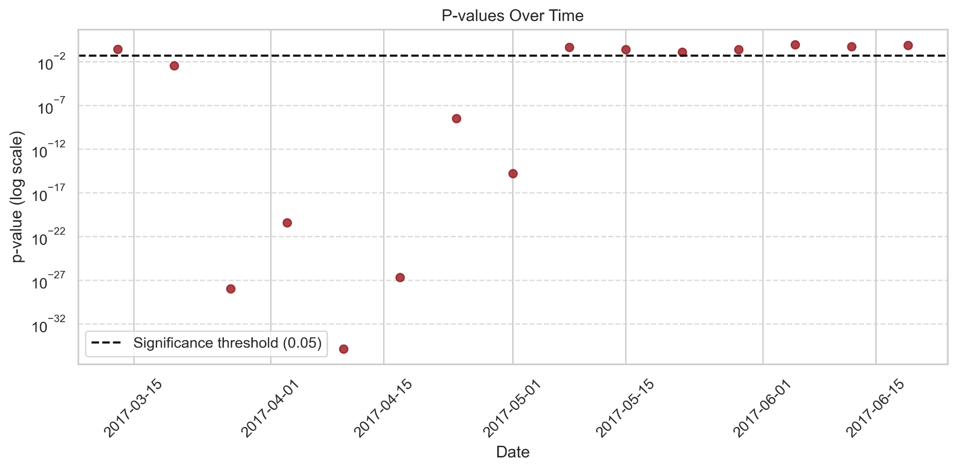
Duration assessment
Chi-square test (per week):
H₀: there is no difference between control and test completion rates
p < 0.05: statistically significant difference
p > 0.05: no statistically significant difference

Slide 16
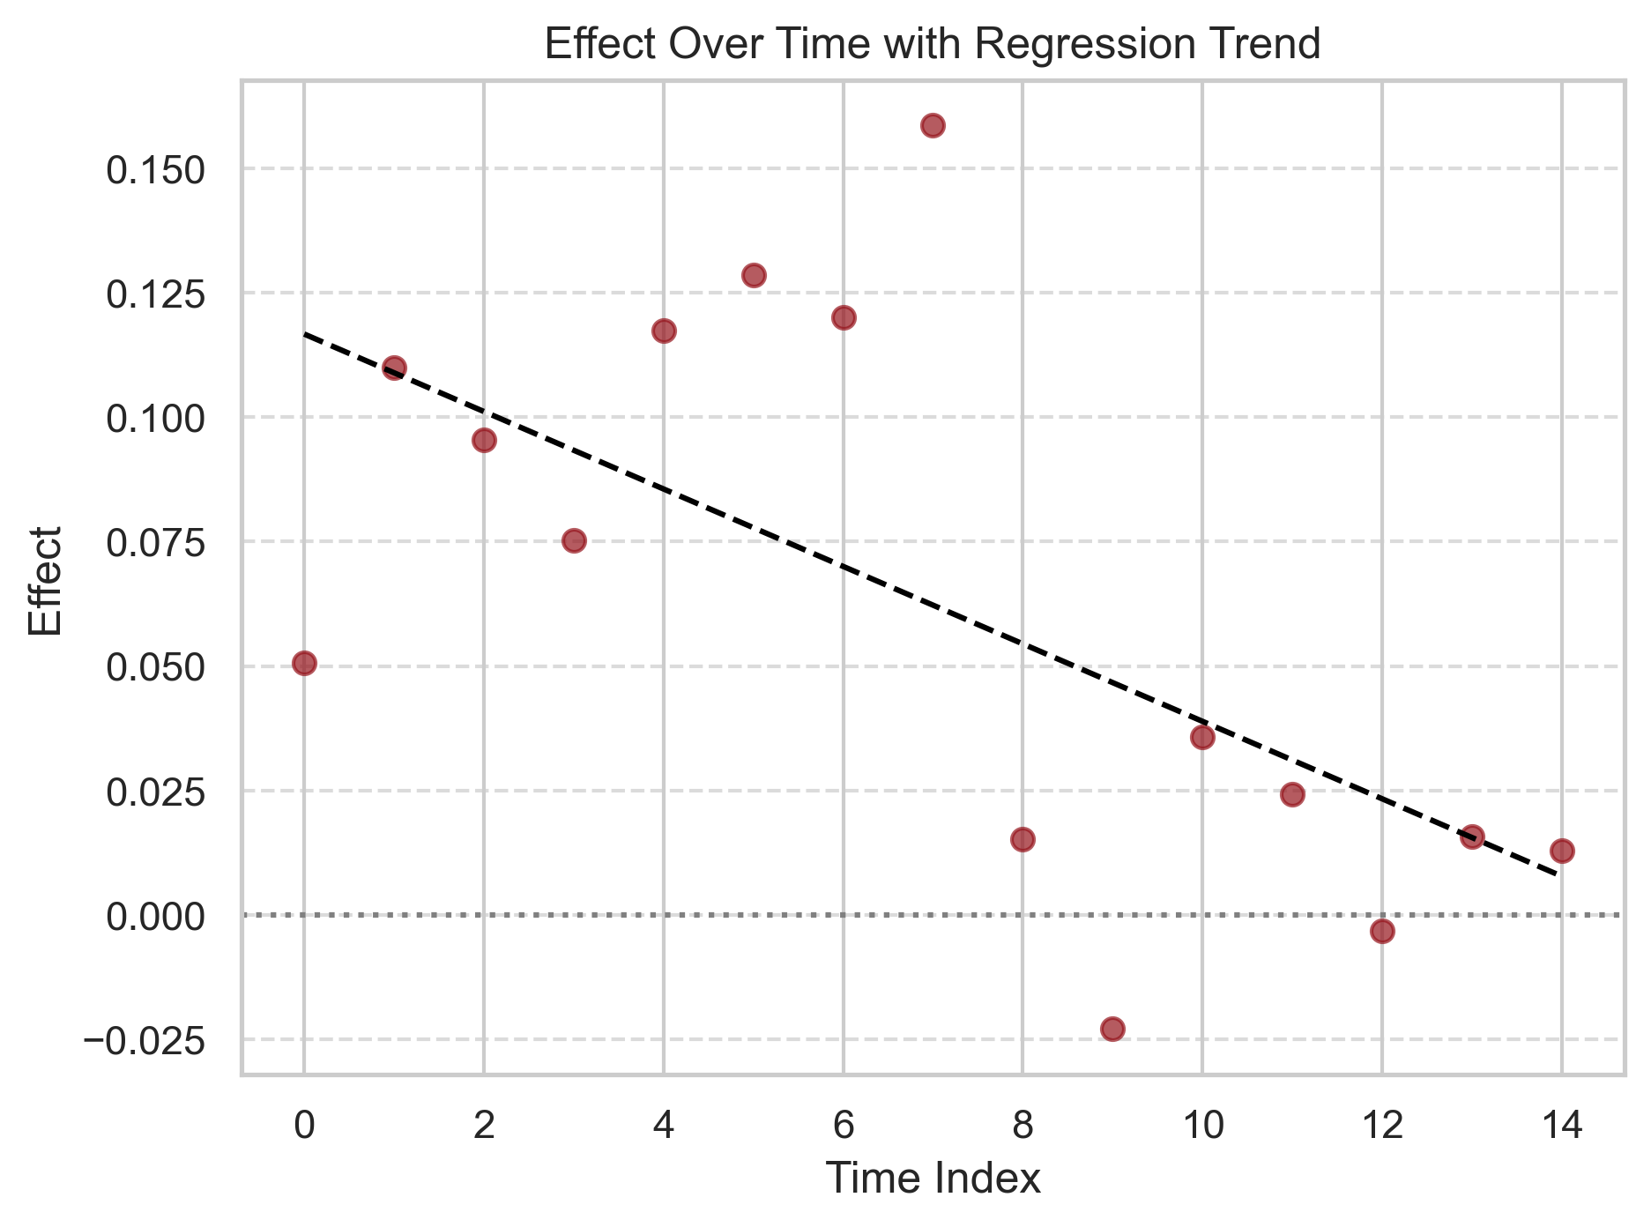
Duration assessment
While short-term impact exists, it is not sustained, meaning aggregate results may overestimate its long-term value.

Slide 17
Conclusion
1: Completion Rate
H₀: The new design does not increase the completion rate compared to the old design. The completion rate in the Test group is less than or equal to the completion rate in the Control group.
We reject the H₀ as the completion rate improves significantly with the new UI
2: Completion Rate with a Cost-Effectiveness Threshold
H₀: The new process design does not achieve the minimum required increase in completion rate. The difference in completion rate between the test group and the control group is less than 5%, meaning the new design is not cost-effective
We reject the H₀ as the new UI design meets the requirements of a minimum 5% relative lift to be cost-effective.
3: Completion Rate according to tenure years
H₀: The completion rate of the new process does not differ significantly from the old process across tenure groups
We reject the H₀ as the completion rate per tenure group improves significantly with the new UI.

Slide 18
Business Recommendation
The new UI shows promise and already meets the 5% cost-effectiveness threshold (observed improvement: 5.65% relative lift). We recommend full implementation at this stage.
Key actions to improve the new UI:
Investigate and reduce process drop-offs
Resolve process integrity errors
Analyze why a significant number of clients spend between 5 and 8.3 minutes per step, and identify opportunities to streamline and simplify these steps
We are confident that addressing these issues will push completion rates even more.

